Slide 1
Posture Alert device
Nikki Metzger, Christian Ralph, and Daniel Lerner

Slide 2
Project Overview
Wearable posture alert device
For use while sitting
Three 6 DOF sensors
Measure body position and angle

Slide 3
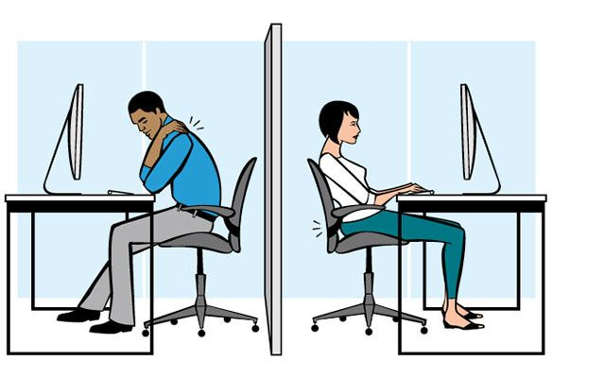
Hunched shoulders
Leaning to the side
Slouching

Slide 4
Changes
No changes to:
Need statement/project scope
Design schedule
Team responsibilities
Some additions to the design specifications

Slide 5
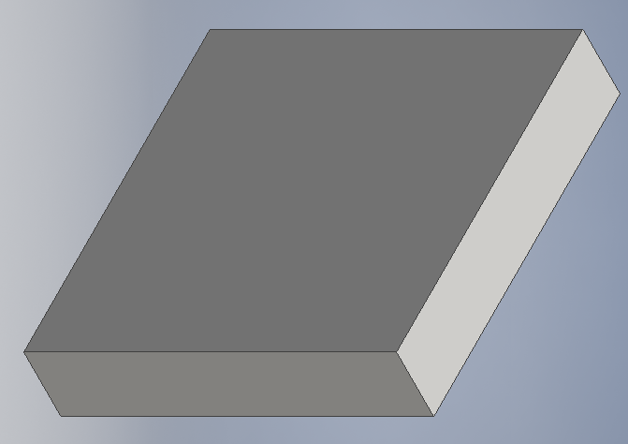
Verification Plan
Safety: possibility of injury risk < 1% per use
Sensor base – heat generation
Foam tape – skin irritation
Design safe analysis
Notes:
Can I only talk about the most important specs?

Slide 6
Verification Plan
Accuracy: accurate detection 85% of the time
Instruct user how to sit (position and angle)
Must correctly determine the position
Reliability: reliable 85% of the time
Let user sit ‘naturally’ (not instructed)
Must consistently detect the position and determine if it’s poor posture

Slide 7
Verification Plan
Feedback: effective 85% of the time
Tactile feedback
Effectively notifies user
Latency: feedback within 3 minutes
Verify user’s poor posture isn’t temporary movement

Slide 8
Validation Plan
Who?
Male and female
18 - 29 years old
Minimum of 5 participants

Slide 9
Validation Plan
How?
First round:
Lab-setting clinical tests
Validate in isolated positions
85% success rate
Success: detects and notifies for all poor posture positions

Slide 10
Validation Plan
How?
Second round:
‘Office’ setting
Validate for intended use

Slide 11
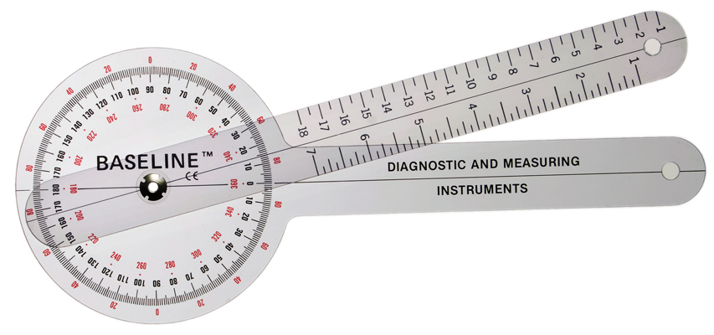
Overall Status
Proof of concept testing
Verify IMU sensors register posture change
Compare sensor values to goniometer measurements

Slide 12
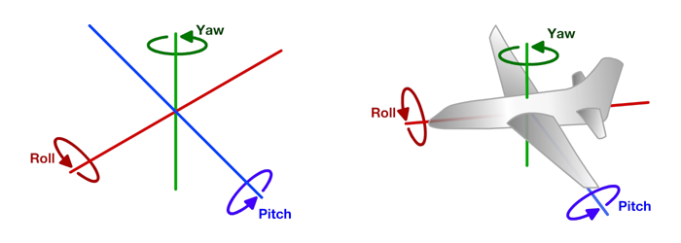
Sensors measure yaw, pitch, and roll

Slide 13
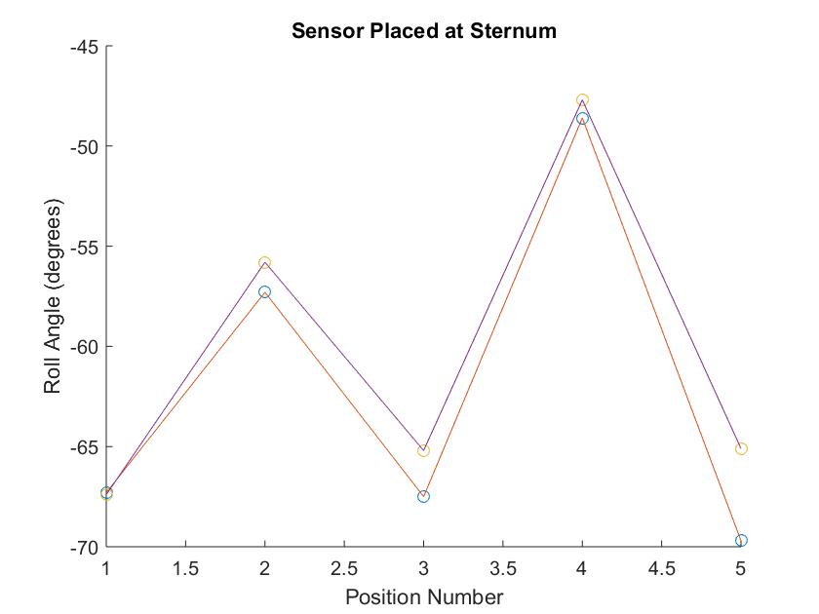
Results of Proof of Concept (Overview)
Sensor at sternum
roll angle

Slide 14
Questions?

Slide 15
Results of Proof of Concept
Posture Position | Hip Angle (deg) | Yaw (deg) | Pitch (deg) | Roll (deg)
Trial 1
Resting | N/A | 15.5 | 8.5 | -67.3
Lean Forward | 6 | 16.4 | 8.6 | -57.3
Return to Rest 1 | 0 | 11.4 | 4.7 | -67.5
Lean Forward | 14 | 16.2 | 8.7 | -48.6
Return to Rest 2 | -5 | 5.7 | 1.4 | -69.7
Trial 2
Resting Position | N/A | 7.3 | 5.1 | -67.4
Lean Forward | 10 | 7.8 | 5.6 | -55.8
Return to Rest 1 | -2 | 6.1 | 3.5 | -65.2
Lean Forward | 11 | 6.8 | 7.2 | -47.7
Return to Rest 2 | -2 | 1.4 | -0.1 | -65.1

Slide 16
Results of Proof of Concept
Posture Position | Hip Angle (deg) | Yaw (deg) | Pitch (deg) | Roll (deg)
Trial 1
Resting | N/A | 35.4 | -5.2 | 52.5
Lean Forward | 10 | 55.9 | -13.1 | 47
Return to Rest | -2 | 35 | -1 | 55.7
Trial 2
Resting Position | N/A | 40 | 0.11 | 55.44
Lean Forward | 7 | 59.8 | -9.2 | 53.9
Lean Forward | 16 | 86.5 | -18.2 | 48.3
Return to Rest | -1 | 65.71 | 0.34 | 56.8

