Slide 1
On the Road to Correcting Poor Posture
Christian Ralph, Daniel Lerner, and Nikki Metzger

Slide 2
Presentation Overview
Modifications to Project Scope / Design Specifications
Design Alternatives Developed
Pugh Chart Analysis of Design Alternatives
Solution Overview
Proposed Budget

Slide 3
Problem
Multi billion dollar problem
Time off for workers & worker injuries
Long term negative effects

Slide 4
Needs Statement
We will develop a way to detect poor posture in users and relay feedback to them

Slide 5
Modifications to Project Scope / Design Specifications

Slide 6
Project Scope
System that uses sensors to detect poor posture by April 2017
Software program to process sensor data & provide feedback

Slide 7
Modified general specifications:
Sensors to measure positioning at pelvis and sternum
Design Specifications more specific metrics
Project Timeline and Team Responsibilities kept the same

Slide 8
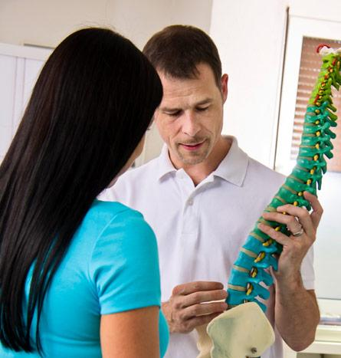
The Gold Standard
Physical Therapist to determine user’s poor posture
Personalized, Accurate, Reliable, and Dependable Feedback
Costly, logistically infeasible
Not practical on a large scale
http://www.lifefitnesspt.com/blog/wp-content/uploads/2013/09/Physical-Fitness-for-weight-loss.jpg

Slide 9
Design Alternatives Developed

Slide 10
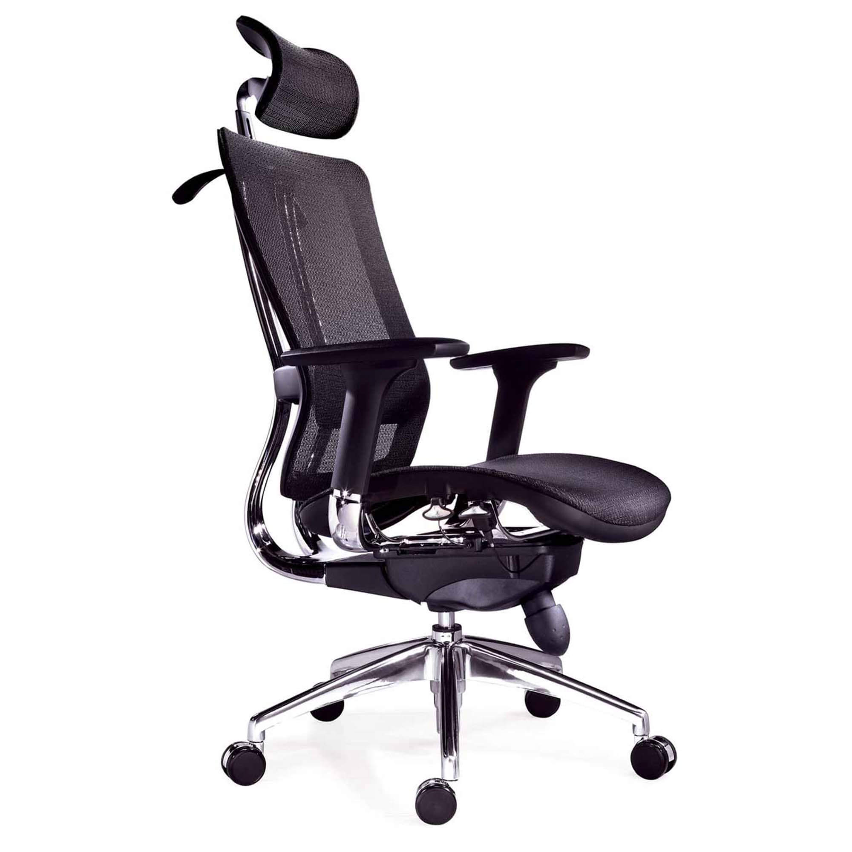
Active Posture Design Alternatives
New Chair Design
Harness Device
Body Positioning Chair Attachment
Figure 1: https://www.gentlemansgazette.com/wp-content/uploads/2015/10/A-completely-adjustable-ergonomic-chair.jpg

Slide 11
Active Posture Design Alternatives
New Chair Design
Harness Device
Body Positioning Chair Attachment
Figure 1: https://www.gentlemansgazette.com/wp-content/uploads/2015/10/A-completely-adjustable-ergonomic-chair.jpg

Slide 12
Active Posture Design Alternatives
New Chair Design
Harness Device
Body Positioning Chair Attachment
Figure 1: https://www.gentlemansgazette.com/wp-content/uploads/2015/10/A-completely-adjustable-ergonomic-chair.jpg

Slide 13
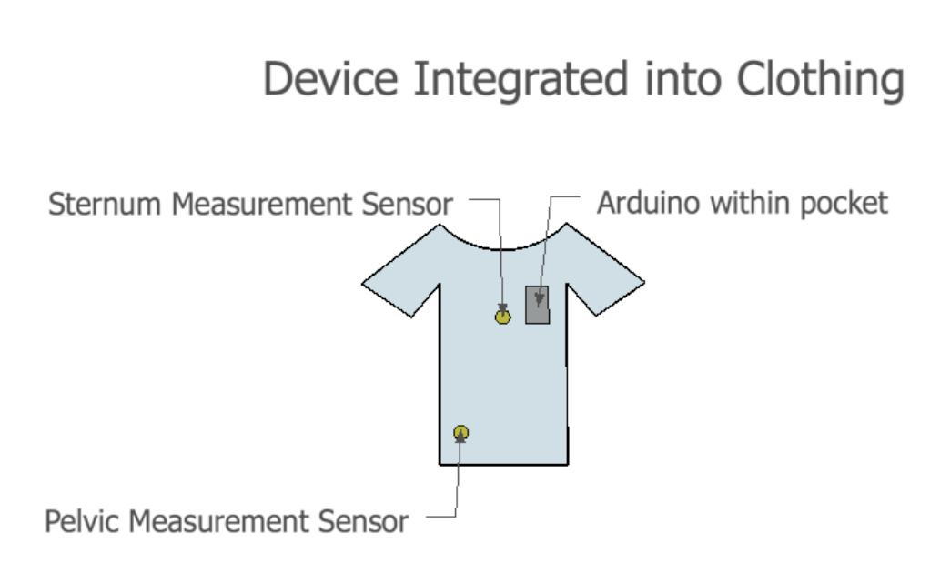
Sensor Device Alternatives
Device on a Belt
Clothing Integrated Device
Wearable Vest Design
Device on the Body
Device Attached to Shirt
Pressure Pad Seat Cushion
Figure 2: Sketch of Device Integrated into Clothing Solution

Slide 14
Sensor Device Alternatives
Device on a Belt
Clothing Integrated Device
Wearable Vest Design
Device on the Body
Device Attached to Shirt
Pressure Pad Seat Cushion
Figure 2: Sketch of Device Integrated into Clothing Solution

Slide 15
Sensor Device Alternatives
Device on a Belt
Clothing Integrated Device
Wearable Vest Design
Device on the Body
Device Attached to Shirt
Pressure Pad Seat Cushion
Figure 2: Sketch of Device Integrated into Clothing Solution

Slide 16
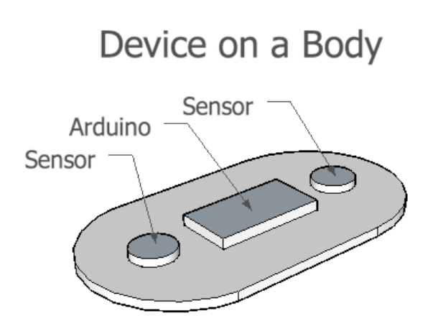
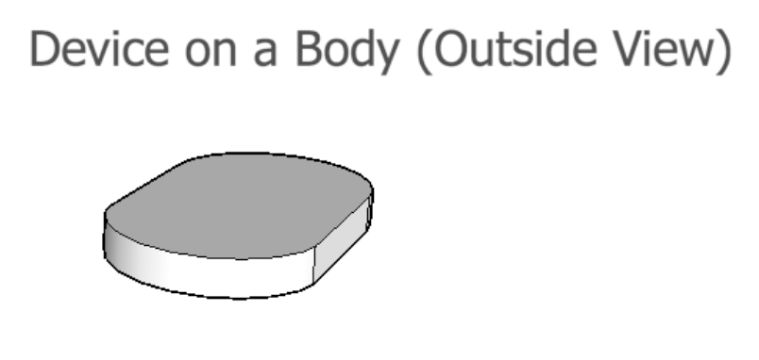
Sensor Device Alternatives
Device on a Belt
Clothing Integrated Device
Wearable Vest Design
Device on the Body
Device Attached to Shirt
Pressure Pad Seat Cushion
Figure 3: Device on Body (Outside View) Solution
Figure 4: Device on a Body Solution

Slide 17
Sensor Device Alternatives
Device on a Belt
Clothing Integrated Device
Wearable Vest Design
Device on the Body
Device Attached to Shirt
Pressure Pad Seat Cushion
Figure 3: Device on Body (Outside View) Solution
Figure 4: Device on a Body Solution

Slide 18
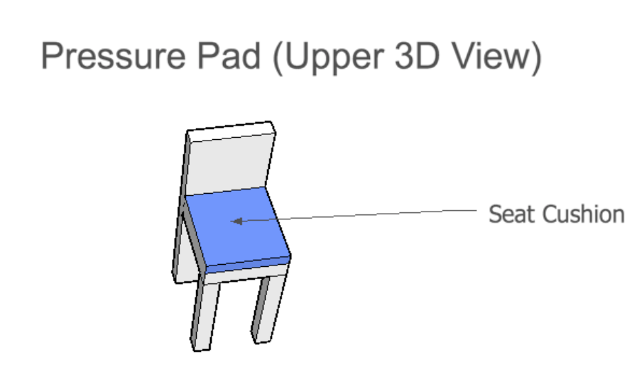
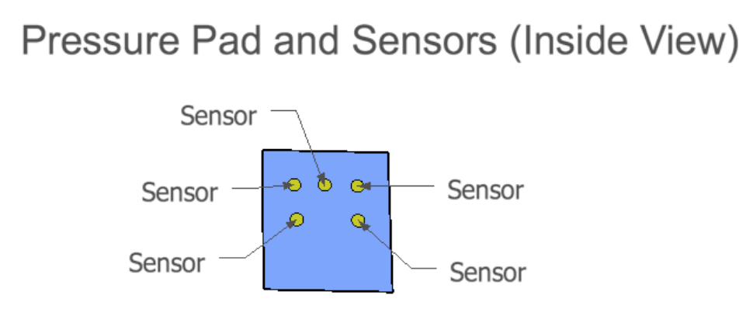
Sensor Device Alternatives
Device on a Belt
Clothing Integrated Device
Wearable Vest Design
Device on the Body
Device Attached to Shirt
Pressure Pad Seat Cushion
Figure 5: 3D View of Pressure Pad Solution
Figure 6: Inside View of Sensors in Pressure Pad Solution

Slide 19
Software-based Design Alternatives
Reminder System
Exercise Routine Tracker
Wearable Sensors & Computer Processor
Camera to Detect Angles
Figure 7: http://www.rentfaxpro.com/wp-content/uploads/2015/04/software.png

Slide 20
Software-based Design Alternatives
Reminder System
Exercise Routine Tracker
Wearable Sensors & Computer Processor
Camera to Detect Angles
Figure 7: http://www.rentfaxpro.com/wp-content/uploads/2015/04/software.png

Slide 21
Software-based Design Alternatives
Reminder System
Exercise Routine Tracker
Wearable Sensors & Computer Processor
Camera to Detect Angles
Figure 7: http://www.rentfaxpro.com/wp-content/uploads/2015/04/software.png

Slide 22
Pugh Chart Analysis

Slide 23
Table 1: Categories for Pugh Chart Analysis
Category: | Description:
Safety | How risky use of solution proves to user’s health.
Invasiveness | How much use of solution interferes in user’s life.
Cost | How expensive it is in both time and capital to create the solution.
Portability | How easy it is to transport the solution from one place or another.
Feedback | The efficiency and usefulness of prompts to correct posture
Usability | The ease of use, including setup and potential calibration(s)
Accuracy | How small margin of error is for measuring body positioning
Reliability | How consistent the measurements are over multiple trials
Latency | How quickly the system provides feedback
Longevity | How long the solution can reliably be used

Slide 24
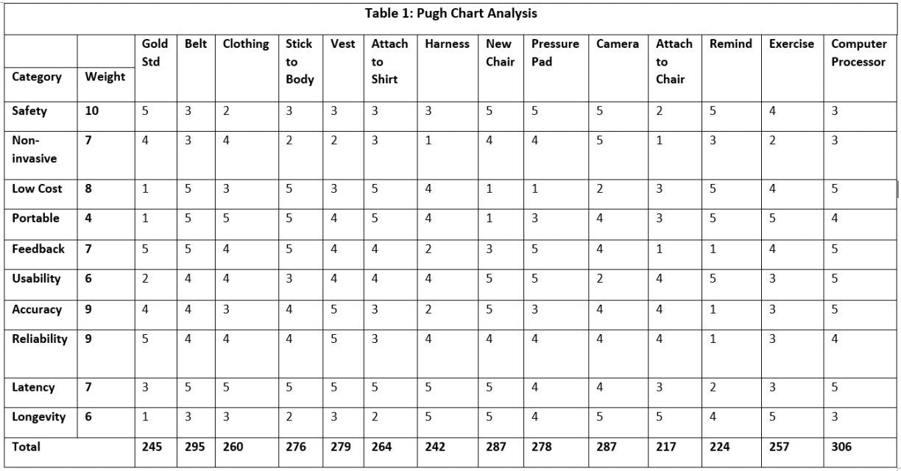

Slide 25
Solution Overview
6 Degree of Freedom (DOF) IMU sensors placed at the sternum and pelvis
Microprocessor to receive data
Software program to collect and process data

Slide 26
Proposed Budget

Slide 27
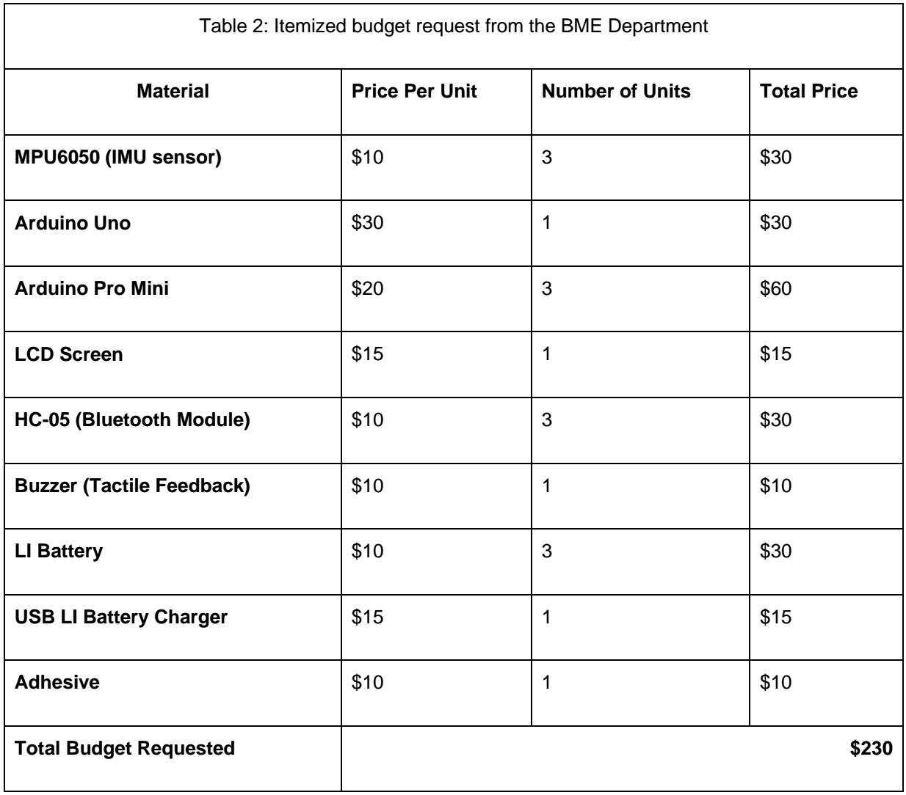

Slide 28
Questions?

