Slide 1
How Good Is Your Posture?
Nikki Metzger, Christian Ralph, and Daniel Lerner

Slide 2
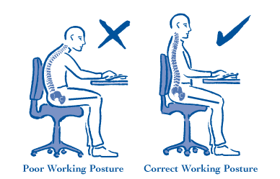
Background - Good vs. Bad Posture
Good Posture
An even distribution of forces throughout the body
Minimal wear on the joints
Natural muscle length
Normal range of motion
Proper placement of vital organs.

Slide 3
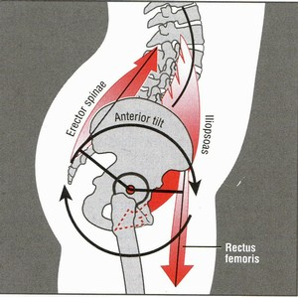
Effects of Bad Posture
Poor posture can cause musculoskeletal disorders (MSDs), such as:
Carpal Tunnel Syndrome
Tendonitis
Muscle or tendon strain
Ligament sprain
Tension headaches
Ruptured/herniated disk
Anterior Pelvic Tilt
Notes:
Anterior Pelvic tilt:
Tightened hip flexors, quadriceps, and erector spinae (lower back)
Weakened hamstrings, glutes, and abdominals
Causes increase in the arch of the lower back
Over time can result in chronic tilt and pain

Slide 4
Impact of Back Pain
#2 reason for work absences
Cost $50 billion in 2011
30% of all worker’s compensation costs
~45% of workers between ages 35 and 55 suffer

Slide 5
Population
The average office worker/student
Seated for 10+ hours every day
Could develop problems from poor seated posture

Slide 6
Environment
Indoors
Solution to benefit indoor workers

Slide 7
Market
Those who have poor seated posture, and are currently are experiencing pain

Slide 8
Existing Solutions

Slide 9
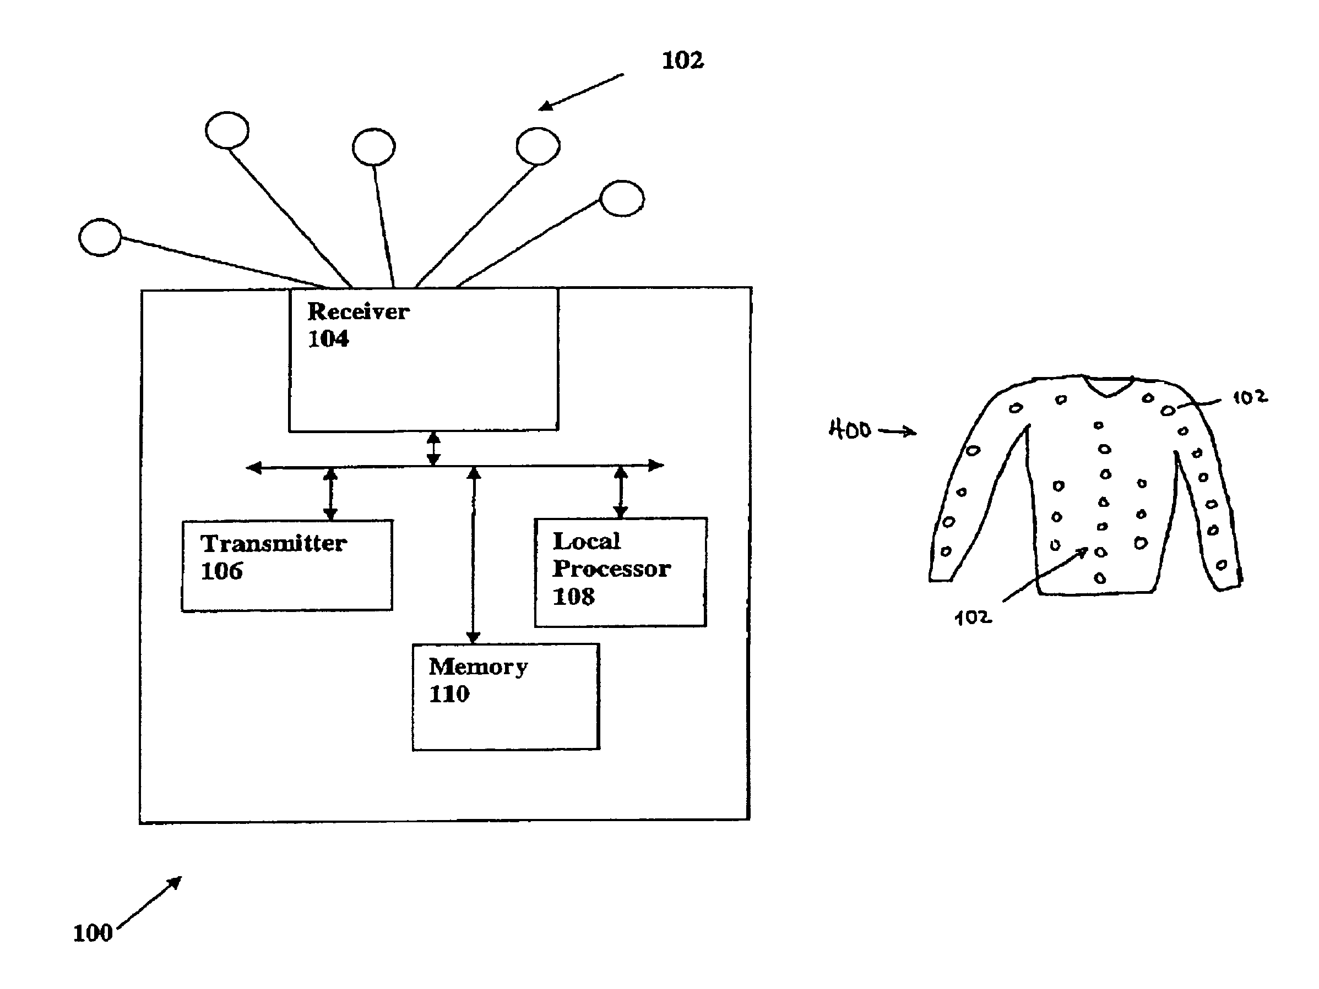
Passive Options
Posture Alert System
Vest contains many sensors to accurately determine curvature of the spine
Sends tactile or audio feedback to user when poor posture is detected
Must be set up by a physician
Not meant for daily use
US patent no. 11,315,690

Slide 10
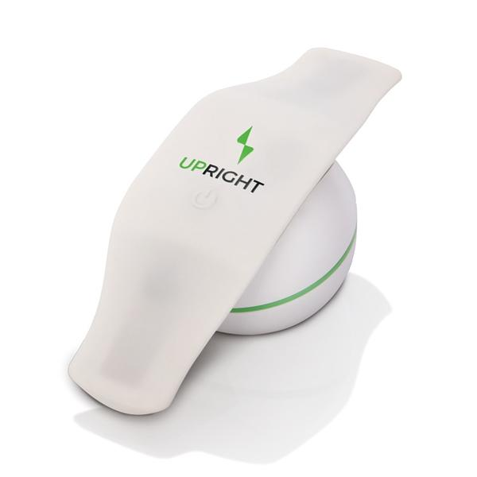
Passive Options
UPRIGHT Posture Trainer
More modern solution
Attaches via adhesives to the back
Detects poor posture by the stretching of the material within the device itself

Slide 11
Passive Options
Posture Training Device
Vest embedded with individual posture devices that detect poor posture
Individual device alerts the user via vibration
Vest is a cumbersome addition to everyday life
US patent no. 5,749,838

Slide 12
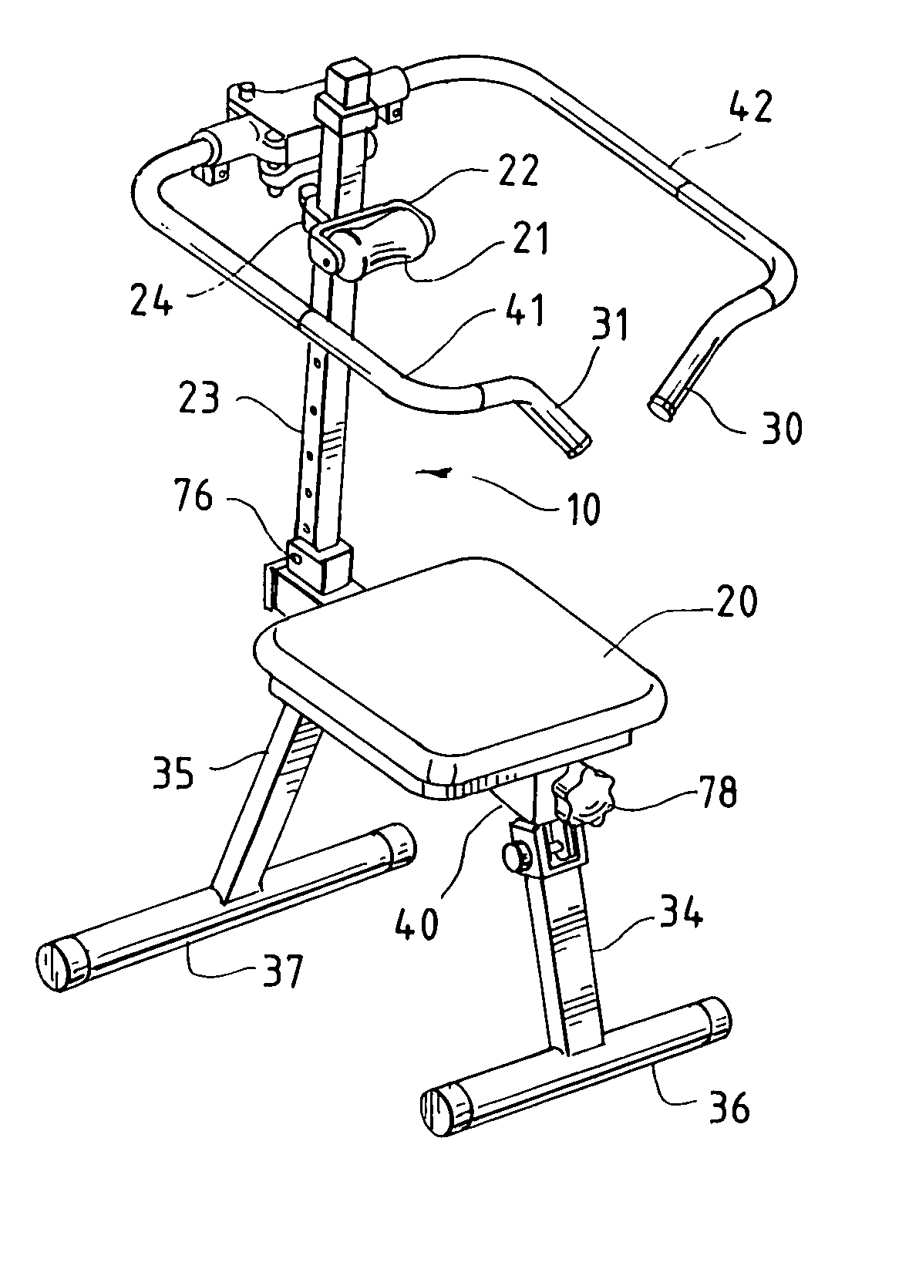
Active Solutions
Posture Correction Exercise Device
Physically moves spine into correct alignment
Helps to reduce back and muscular pain
Practically impossible to use during the workday
US Patent no. 7,086,992
Notes:
Include lumbar supports (to use in a chair) and back braces

Slide 13
Our Proposal

Slide 14
A way to improve poor posture for individuals working long hours while seated.

Slide 15
We are going to deliver a device that alerts user of poor posture.

Slide 16
Objective: Complete prototype by April, 2017

Slide 17
General Specifications
Indoor, office environment
Used while sitting for extended periods of time
Adult use
Determines user’s incorrect posture
Alerts user of poor posture
Unobtrusive
Battery-operated

Slide 18
Specific Design Metrics
Metric | Value
Cost of first prototype | Under $200
Cost of final prototype | Under $300
Length of use | 6-8 hours each day
Battery Life | 20-24 hours (3 days of work use)
Battery recharge time | At most 8 hours (for overnight charging)

Slide 19
Specific Design Metrics
Metric | Value
Device proximity | Less than 1m from user
Calibration time | Less than 15 minutes
Device size | Smaller than (45cm x 45cm x 100cm) (size of standard office chair)
Device weight | Less than 3kg

Slide 20
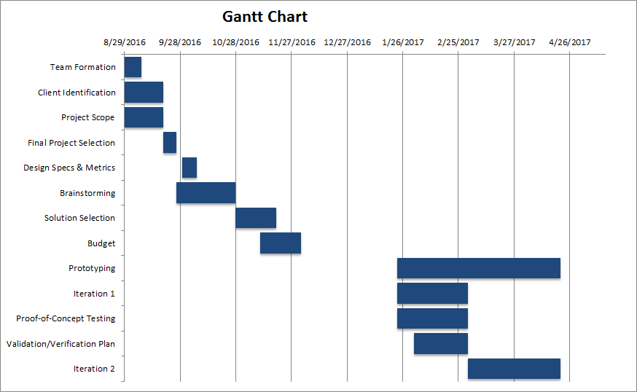
Gantt Chart

Slide 21
Team Responsibilities
Daniel Lerner:
Software, technical drafts
Christian Ralph:
Research, note taking
Nikki Metzger:
Team organization, external communication, and weekly reports

Slide 22
Questions?

