Slide 1
Posture Alert Device
Daniel Lerner, Nikki Metzger, Christian Ralph

Slide 2
Recap
3 sensors: 1 on each hip and 1 on sternum
Testing 4 different posture positions
Hunched shoulders
Slouched
Leaning left
Leaning right
Notes:
Christian

Slide 3
Prototype

Slide 4
Prototype Design
Notes:
Daniel

Slide 5
Design Specifications

Slide 6
Overview of Specifications
Feedback - Model able to alert user of poor posture position
Latency - Device provides feedback within 3 min of detecting poor posture
Accuracy - Correct indication of poor posture
Reliability - Consistent sensor data across multiple trials
Notes:
Daniel

Slide 7
Video of Working Prototype
Notes:
Daniel

Slide 8
Results of V&V Testing

Slide 9
Our Testing Procedure
5 trials in each posture position
Good posture → bad posture is one trial
Change in position angles determines posture model
Notes:
Daniel

Slide 10
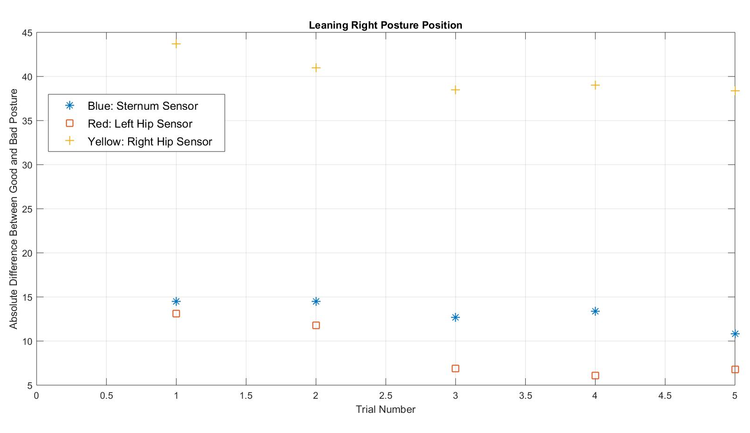

Slide 11
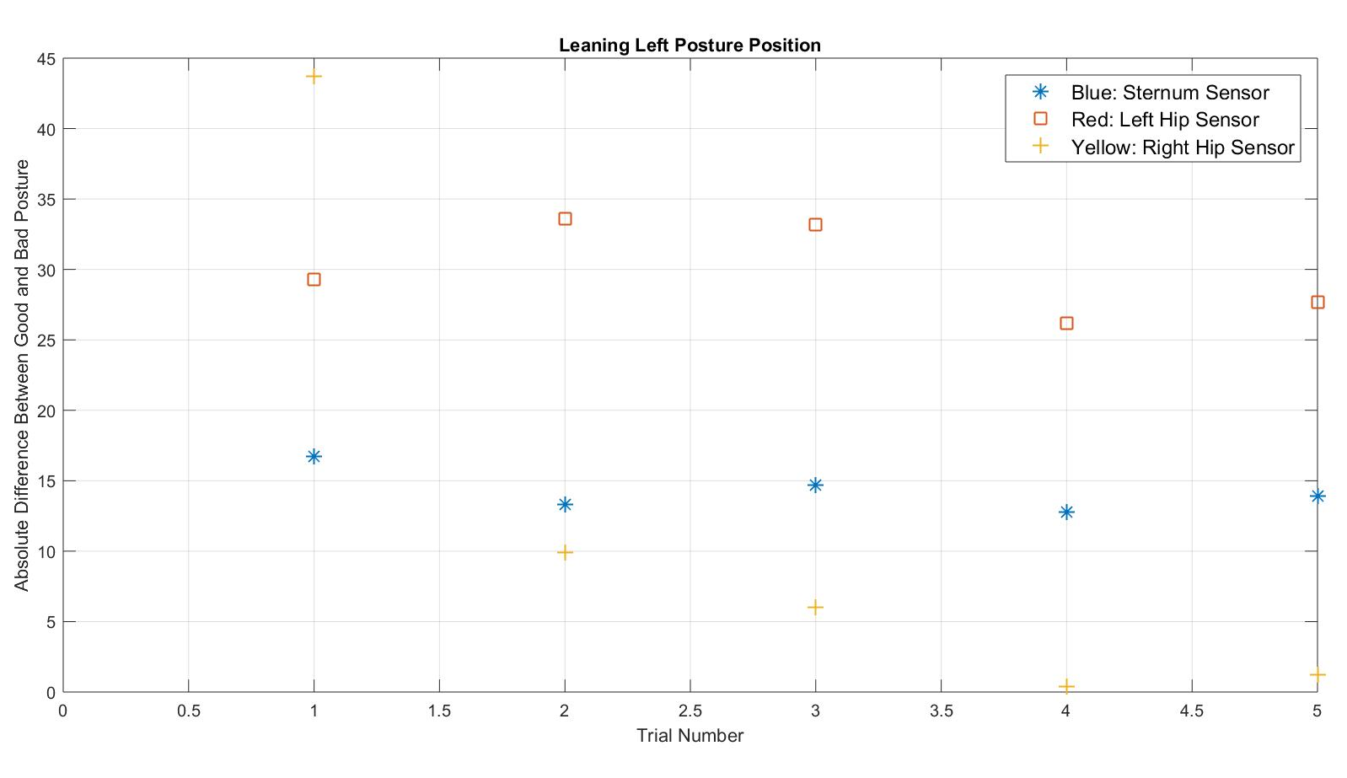

Slide 12
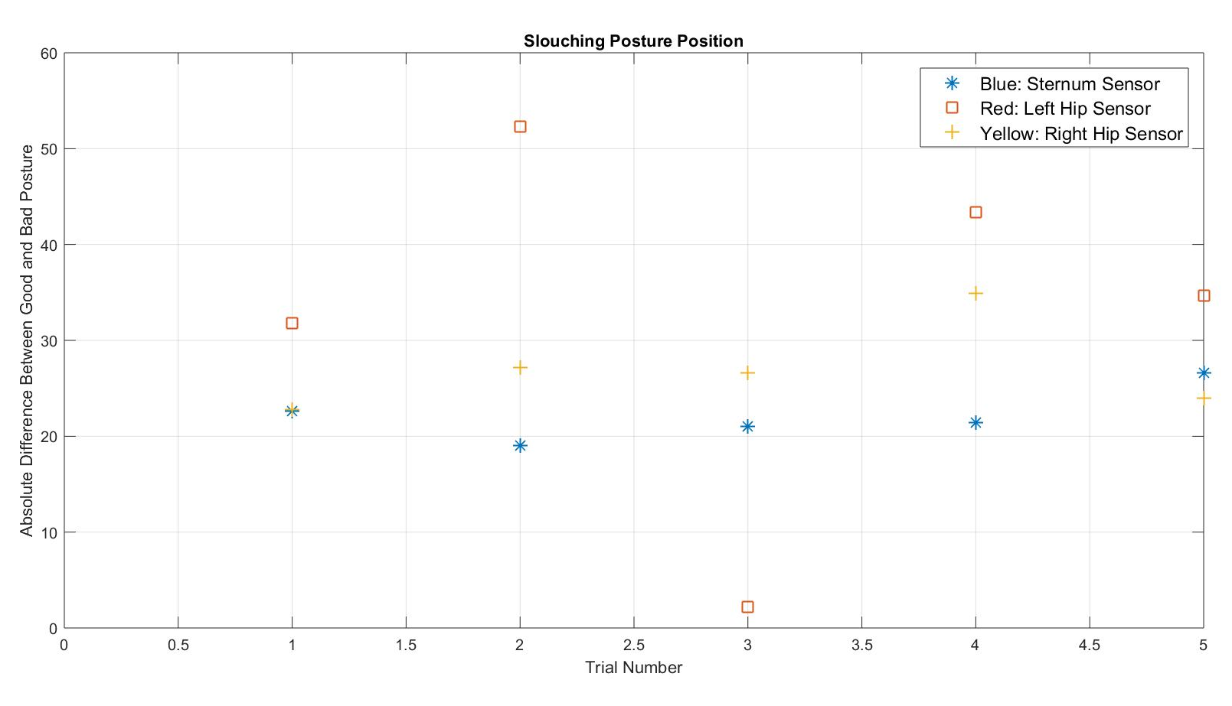

Slide 13
Concluding Thoughts
Project Challenges:
Creating a dynamic model for all positions
Delays with software coding
Notes:
Christian

Slide 14
Concluding Thoughts (Continued)
Future Directions:
Transition to Bluetooth
Design that conforms to human body
Aesthetics
Notes:
Christian

